Slide 1
Chapter 5 Mini Case
Answers Summary

Slide 2
a. Features of a bond
There are three main features of a bond which include: -
Face value
Maturity
Coupon

Slide 3
b. What are call options and sinking provisions
Call option: it’s the right of issuing corporation to call bonds for redemption.
Sinking fund: it’s a provision facilitates the orderly retirement of the bond issue.
The call provision bonds are valuable to the firm but not with the investor if at the time of the bond issuance, the interest rates are high. This can be considered a risky provision while the sinking fund provision bonds are considered less risky than the ones without a provision.

Slide 4
c. Determining the value of any asset
Cash flow method can be used to determine the value of an asset when there are a series of expecting future cash flows. The information needed for the cash flow method includes the asset’s required rate of return, the time period for the expected cash flows, the interest payment frequency, and the future value of the asset. Each cash flow is then discounted back to current period using the required rate of return as the discount rate. The asset’s value is the sum of the present value of each cash flow.

Slide 5
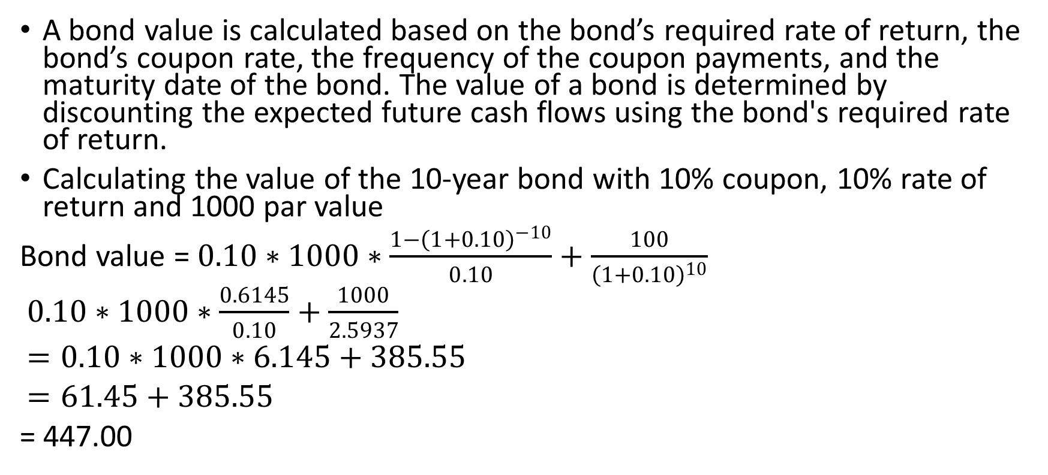
d. How is the value of a bond determined?
A bond value is calculated based on the bond’s required rate of return, the bond’s coupon rate, the frequency of the coupon payments, and the maturity date of the bond. The value of a bond is determined by discounting the expected future cash flows using the bond's required rate of return.
Calculating the value of the 10-year bond with 10% coupon, 10% rate of return and 1000 par value
Bond value = $0.10∗1000∗\frac{1−{\left(1+0.10\right)}^{−10}}{0.10}+\frac{100}{{\left(1+0.10\right)}^{10}}$
$0.10∗1000∗\frac{0.6145}{0.10}+\frac{1000}{2.5937}$
$=0.10∗1000∗6.145+385.55$
$=61.45+385.55$
= 447.00

Slide 6
e. Increasing the bond by 3% what would happen?
The value of the described bond (with the inflation rising 3 percentage points) would now be: 837.213. This would now be a discount bond.
The value of the bond would increase to 1210.71. This bond would now be a premium bond.
If it remained at 13%: The closer the bond reaches the maturity date, the more discounted it becomes. If it remained at 7%: The closer the bond reaches the maturity date, the more the premium increases.

Slide 7
Question f
1. $887.00 = $90(PVIFAk,10) + $1,000(PVIFk,10)
2. Where k is the bond's YTM. The best way to solve for k = YTM is to use a financial calculator with a bond valuation capability. Input the following into your financial calculator: N=10, PV=-887.0, PMT=90, FV=1,000, and then solve for I = k = YTM = 10.91%. Because the YTM is greater than bond’s coupon rate, this bond is selling at a discount.

